Slide 1
Grading Scheme: Absolute
Assessment | Weightage
Assignments | 10%
Quizzes | 5%
Sessional 1 & 2 | 30% (15% Each)
Project | 15%
Finals | 40%

Slide 2
Chapter 1
Introduction to databases

Slide 3
Chapter 1 - Objectives
Some common uses of database systems.
Characteristics of file-based systems.
Problems with file-based approach.
Meaning of the term database.
Meaning of the term Database Management System (DBMS).

Slide 4
Chapter 1 - Objectives
Typical functions of a DBMS.
Major components of the DBMS environment.
Personnel involved in the DBMS environment.
History of the development of DBMSs.
Advantages and disadvantages of DBMSs.

Slide 5
Examples of Database Applications
Purchases from the supermarket
Purchases using your credit card
Booking a holiday at the travel agents
Using the local library
Taking out insurance
Renting a video
Using the Internet
Studying at university

Slide 6
History:
Computers initially used for computational / engineering process
After some time it has been thought that why should not used computer for commercial application. So in this way some languages were being used for such purpose like COBOL language.
Commercial application introduced File Processing System
Commercial application means no maximum calculation / computation involve.
Only data processing (Read/store/minor calculation) and then get output either on Monitor or paper.

Slide 7
File-Based Systems
Collection of application programs that perform services for the end users (e.g. reports).
Each program defines and manages its own data.

Slide 8
File-Based Systems
Each system maintain data and processing
Each system has own data and program/Application. Each system store there own data separately and process independently.
Each system have own program for the purpose of processing (Read / Store / Minor Calculation / output on the screen).
In each system program and data are interdependence because program and data are depended on one another.

Slide 9
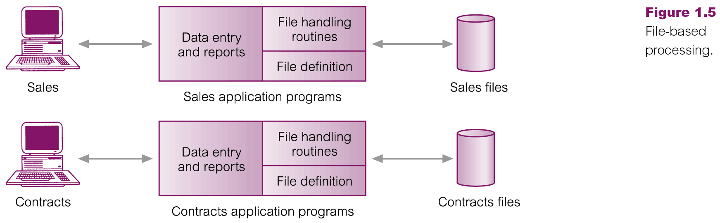
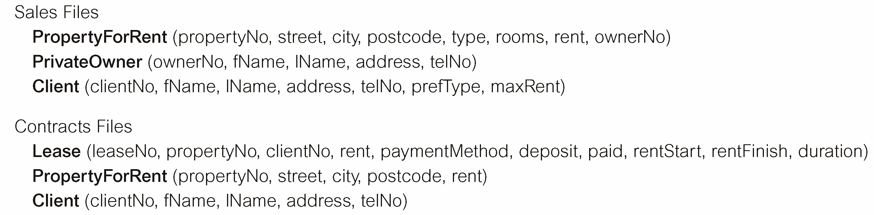
File-Based Processing

Slide 10
Limitations of File-Based Approach
Program-Data Dependence
All programs maintain metadata for each file they use
Duplication of Data
Different systems/programs have separate copies of the same data
Limited Data Sharing
No centralized control of data
Lengthy Development Times
Programmers must design their own file formats
Excessive Program Maintenance
80% of information systems budget

Slide 11
Limitations of File-Based Approach
Incompatible file formats
Programs are written in different languages, and so cannot easily access each other’s files.
Fixed Queries/Proliferation of application programs
Programs are written to satisfy particular functions.
Any new requirement needs a new program.

Slide 12
Problems with Data Dependency
Each application programmer must maintain his/her own data
Each application program needs to include code for the meta data of each file
Each application program must have its own processing routines for reading, inserting, updating, and deleting data
Lack of coordination and central control
Non-standard file formats

Slide 13
Problems with Data Dependency
If data is being changed then the program must be changed and vice versa For example if a library system has some attributes about book like.
Book_id
Book_name
Book_title
Book_author
And after some time we add an other attribute like
book_edition. So you need to change data but on other
hand you have to change the program as well because
program is dependent on data and vice versa It means that
if you change the data in library system you will have to
change Examination and Registration systems.

Slide 14
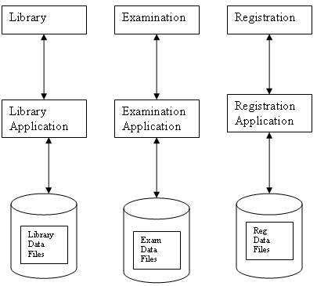

Slide 15
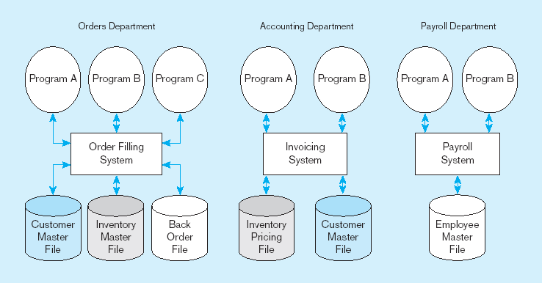
Figure 1-3 Old file processing systems at Pine Valley Furniture Company
Duplicate Data

Slide 16
Problems with Data Redundancy
Waste of space to have duplicate data
Causes more maintenance headaches
The biggest problem:
Data changes in one file could cause inconsistencies
Compromises in data integrity

Slide 17



Data Duplication:

Slide 18
No data sharing concept and inconsistency
Attribute Address appears in two systems, Examination and Registration. (Duplication)
It creates inconsistency
for example if a student changes his address in registration system and not updated examination
Address of student is different for registration information communication and examination information communication.

Slide 19
SOLUTION: The DATABASE Approach

Slide 20
Definitions
Database:
A database is a shared collection of logically related data, which is stored to meet the requirement of different users of an organization
Data: Raw facts about any thing.
stored representations of meaningful objects and events
Structured: numbers, text, dates
Unstructured: images, video, documents

Slide 21
Definition1
Logically related data: for example a man is working in a company and we want to get facts/data about such worker. We can gather many data like
Necessary Data
Name
FName
Address
So many….
Unnecessary Data
Size of shoe
Hair color
Height
Weight
Eye color
So many….

Slide 22
Definition1
Is such data required for an organization?
Is such data important for an organization?
Is such data useful for an organization?
An organization may have different systems for example a factory may have following systems
Sales system
Purchase system
Payroll/Account system
Production system
BUT THE DATA IN ALL OF ABOVE SYSTEMS IS LOGICALLY RELATED

Slide 23
Definition1
Shared Collection: There are some data that is common for different systems. Such data must not be duplicated and that should be shared

Slide 24
Definition 2:
A database is a self describing collection of integrated records.
Self describing:
In database, there are not only data stored but also structure/definition/checks of that data. (In DBMS it is called Schema/meta data. We will see later in more detail)
Meta data is the part of database

Slide 25
Definition 2:
Integrated record:
Records are linked to one another
When you see a record, to understand full meaning of that record you will have to consider another record.
It means that for understanding of a record you need another record which is linked with it.

Slide 26
Definitions
Information: data processed to increase knowledge of the person using the data.
The processed data is called information (adding some knowledge).
Process means to add something to data.
To name/ label data is also a process.
Process can also add some knowledge, some information to the data

Slide 27

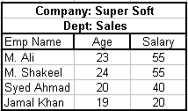
Further processing:
Metadata: data that describes the properties and context of user data

Slide 28
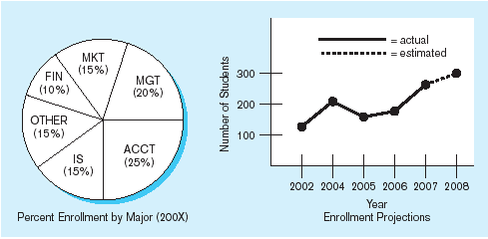
Figure 1-1b Summarized data
Graphical displays turn data into useful information that managers can use for decision making and interpretation

Slide 29
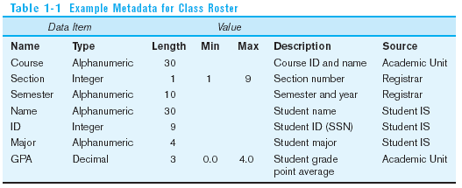
Descriptions of the properties or characteristics of the data, including data types, field sizes, allowable values, and data context

Slide 30
The DATABASE Approach
Data sharing (common data is being stored at one place rather than storing the same on separate terminals)
Data independence: Both data and program are now independent, if you change data in one system, only that system will require the change.
Controlled Redundancy (Duplication)
Better Data Integrity
Data consistency
Better data security

Slide 31
The DATABASE Approach
Control of data redundancy
Data & resource sharing eliminates or at least minimize duplication
Better concurrency control
Multiple users access the data at the same time e.g. ATM
Better Backup and Recovery procedure

Slide 32
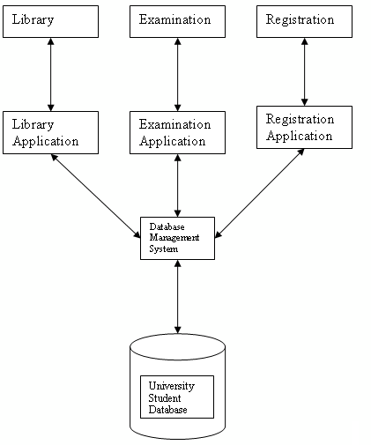
The DATABASE Approach

Slide 33
Database Management System
A software system that is used to create, maintain, and provide controlled access to user databases
Order Filing
System
Central database
Contains employee,
order, inventory,
pricing, and
customer data
Invoicing
System
DBMS
Payroll
System
DBMS manages data resources like an operating system manages hardware resources

Slide 34
Database Management System
(Database) application program: a computer program that interacts with database by issuing an appropriate request (SQL statement) to the DBMS.

Slide 35
Database Approach: Parts of DB
Data Retrieval
Data Manipulation Language (DML).
Transaction Processing (TP)
Data definition language (DDL).
Data Control Language (DCL).
Notes:
Data retrieval select
DML,, insert update, delete
DDL create, alter, drop
DCL grant revoke/e
Transaction process– ensure data integrity (roll back etc)

Slide 36
Views
Allows each user to have his or her own view of the database.
A view is essentially some subset of the database.

Slide 37
Views - Benefits
Reduce complexity
Provide a level of security
Provide a mechanism to customize the appearance of the database
Present a consistent, unchanging picture of the structure of the database, even if the underlying database is changed

Slide 38
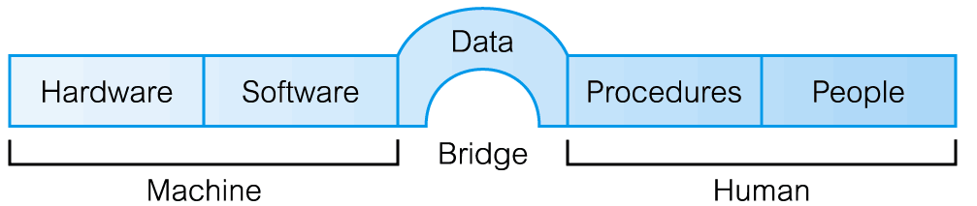
Components of DBMS Environment

Slide 39
Components of DBMS Environment
Hardware
Can range from a PC to a network of computers.
Software
DBMS, operating system, network software (if necessary) and also the application programs.
Data
Used by the organization and a description of this data called the schema.

Slide 40
Components of DBMS Environment
Procedures
Instructions and rules that should be applied to the design and use of the database and DBMS.
People

Slide 41
Roles in the Database Environment
Data Administrator (DA)
Database Administrator (DBA)
Database Designers (Logical and Physical)
Application Programmers
End Users (naive and sophisticated)

Slide 42
History of Database Systems
First-generation
Hierarchical and Network
Second generation
Relational
Third generation
Object-Relational
Object-Oriented

Slide 43
Advantages of DBMSs
Control of data redundancy
Data consistency
More information from the same amount of data
Sharing of data
Improved data integrity
Improved security
Enforcement of standards
Economy of scale

Slide 44
Advantages of DBMSs
Balance conflicting requirements
Improved data accessibility and responsiveness
Increased productivity
Improved maintenance through data independence
Increased concurrency
Improved backup and recovery services

Slide 45
Disadvantages of DBMSs
Complexity
Size
Cost of DBMS
Additional hardware costs
Cost of conversion
Performance
Higher impact of a failure

